Slide 1


Influenza (flu)
Market Update
Preparing for 2022-2023 Season

Slide 2
Less Severe Seasons May Indicate Season of Severe Flu-Related Complications Ahead
CDC Estimates on Flu-Related Deaths and Hospitalizations from 2010-11 to 2021-22 Seasons
?
Deaths^{1,2}
  38,000
  38,000
  34,000
  23,000
  22,000
  12,000
4,500**
  136
  2010-11
  2011-12
  2012-13
  2013-14
  2015-15
  2015-16
  2016-17
  2017-18
  2018-19
  2019-20
  2020-21*
  2021-22
  800,000
?
Hospitalizations^{1,2}
  600,000
  500,000
  490,000
  400,000
  350,000
  280,000
  200,000
  140,000
126,000**
  292
  0
  2010-11
  2011-12
  2012-13
  2013-14
  2015-15
  2015-16
  2016-17
  2017-18
  2018-19
  2019-20
  2020-21*
  2021-22
* Consider the impact of Covid-19 mandates and other social distancing measures when interpreting influenza activity data from 2020-21 season
** Average of ranges for preliminary in-season burden estimates for 2021-2022
Reference: 1. Centers for Disease Control and Prevention (CDC) website. https://www.cdc.gov/flu/about/burden/past-seasons.html. Accessed May 17, 2022. 2. CDC website. 2021-2022 Preliminary In-Season Burden Estimate. https://www.cdc.gov/flu/about/burden/preliminary-in-season-estimates.htm. Accessed July 14, 2022.

Slide 3
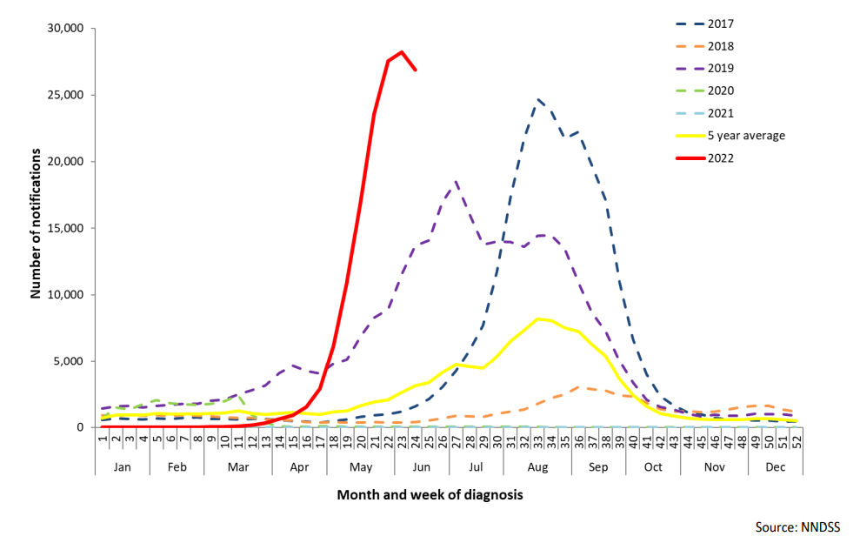
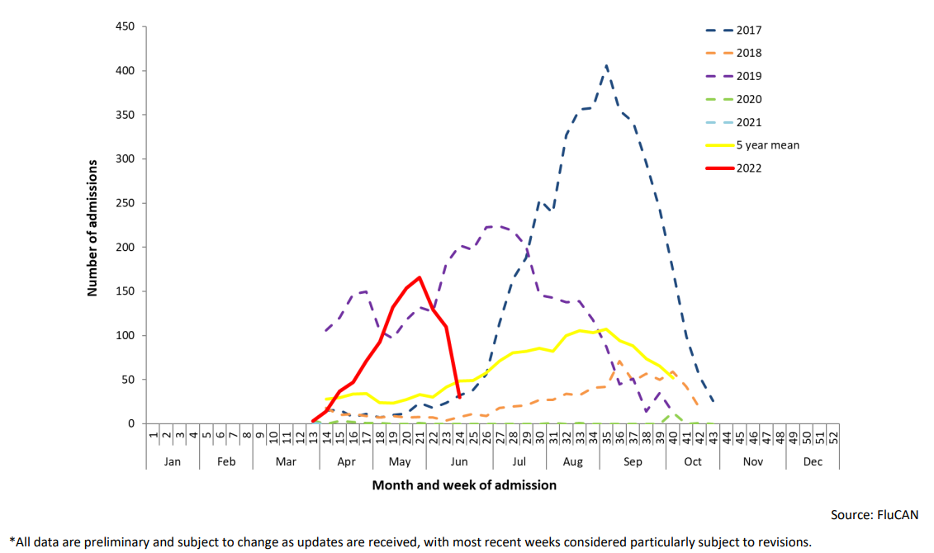
Early Reports of High Levels of Flu Activity in Australia¹, Which Could Allude to Similar Activity in the Northern Hemisphere²
Number of Laboratory-Confirmed Influenza, Australia, January 2017 to June 2022¹
Number of Influenza Hospitalizations at Sentinel Hospitals, Australia, April 2017 to June 2022¹
Data Sources: 1. Australian Government Department of Health. Influenza Surveillance Report. https://www1.health.gov.au/internet/main/publishing.nsf/Content/cda-surveil-ozflu-flucurr.htm/$File/flu-07-2022.pdf. Accessed June 6, 2022. 2. World Health Organization (WHO) website. FluNet Summary. https://www.who.int/tools/flunet/flunet-summary. Accessed July 20, 2022.
Notes:
Q: Are the strains matching up with the confirmed influenza cases? (Control the message)

Slide 4
Even More Critical Than Ever To Reprioritize Influenza Vaccinations In Response To Covid-19 Interference to Vaccine Coverage Rates
Adopting opt-out versus opt-in protocol can allow flu vaccination rates to recover and grow
Data Sources: 1. Sanofi Data on File. IQVIA Claims for Medical (As of April 2) and Retail (As of April 1). Accessed June 13, 2022.

Slide 5

Influenza Guidance
Strain Selection, CDC Recommendations and Coadministration

Slide 6
VRBPAC Recommends the WHO Proposed 2022-2023 Influenza Strains for Northern Hemisphere (NH) Quadrivalent Influenza Vaccines^{1,2}
All NH 2022-2023 Influenza Strains Same as Southern Hemisphere 2022-2023
NH 2021-2022³ | Strain | NH 2022-2023^{1,2}
Egg: A/Victoria/2570/2019 Non-Egg: A/Wisconsin/588/2019 | A (H1N1) | Egg: A/Victoria/2570/2019 Non-Egg: A/Wisconsin/588/2019
Egg & Non-Egg: A/Cambodia/e0826360/2020 | A (H3N2) | Egg: A/Darwin/9/2021* Non-Egg: A/Darwin/6/2021*
B/Washington/02/2019 | B (Victoria) | B/Austria/1359417/2021*
B/Phuket/3073/2013 | B (Yamagata) | B/Phuket/3073/2013
*Strain change for NH 2022-23 vs. NH 2021-22
VRBPAC: Vaccines and Related Biological Products Advisory Committee; WHO: World Health Organization
References: 1. FDA. Influenza Vaccine for 2022-2023 Season. https://www.fda.gov/vaccines-blood-biologics/lot-release/influenza-vaccine-2022-2023-season#:~:text=The%20committee%20recommended%20that%20the%20quadrivalent%20formulation%20of%20cell%2D%20or,B%2FVictoria%20lineage)%3B%20and. Accessed July 14, 2022. 2. WHO. Recommended composition of influenza virus vaccines for use in 2022 northern hemisphere influenza season. https://cdn.who.int/media/docs/default-source/influenza/who-influenza-recommendations/vcm-northern-hemisphere-recommendation-2022-2023/202202_recommendation.pdf?sfvrsn=5c88e006_13&download=true. Accessed February 25, 2022. 3. FDA. Influenza Vaccine for the 2021-2022 Season. https://www.fda.gov/vaccines-blood-biologics/lot-release/influenza-vaccine-2021-2022-season. Accessed July 14, 2022.
Notes:
Q: Why are egg and non-egg strains different? Who is VRBPAC? When did recommendation occur?

Slide 7






CDC Recommends Immunization to Help Protect Against Influenza^{1,3}
Who is at higher risk of developing flu-related complications?²
CDC recommends annual flu vaccination for people at greater risk of severe disease or complications.⁵ These high-risk groups include:⁵
CDC’s Advisory Committee on Immunization Practices (ACIP) recommends that everyone 6 months of age and older should get an influenza (flu) vaccine every season with rare exception.¹
Vaccination to prevent flu and its potentially serious complications is particularly important for people who are at higher risk of developing serious flu complications.¹
Children 6 months to 5 years old
Elderly $≥$ 65 years
Elderly ≥ 65 years
Individuals with chronic medical conditions: cardiac, pumonary, renal, liver diseases or immunosuppression
Pregnant women (any stage of pregnancy)
Healthcare workers
People from certain racial and ethnic minority groups
References: 1. Centers for Disease Control and Prevention (CDC). Key facts about seasonal flu vaccine. https://www.cdc.gov/flu/prevent/keyfacts.htm. Accessed February 25, 2022. 2. CDC website. People at Higher Risk of Flu Complications. https://www.cdc.gov/flu/highrisk/index.htm. Accessed July 14, 2022.

Slide 8
ACIP Recommendation on Flu Vaccines for Adults 65+
CDC’s Advisory Committee on Immunization Practices (ACIP) voted on June 22, 2022, to preferentially recommend the use of higher dose or adjuvanted flu vaccines over standard-dose unadjuvanted flu vaccines for adults 65 years and older. ¹
If none of these three vaccines is available at an opportunity for vaccine administration, then any other age-appropriate standard-dose influenza vaccine should be used.¹
ACIP Grouping Categories¹
Higher Dose
&
Adjuvanted Flu Vaccines
References: 1. CDC website. https://www.cdc.gov/media/releases/2022/s0630-seniors-flu.html Accessed June 30, 2022.

Slide 9


Help Protect Your Community by Co-administering a Flu Shot and Covid-19 Vaccine This Season
Add a flu shot to your eligible patient’s next visit and avoid missed opportunities¹
Best practices for multiple injections include:¹
Label each syringe with the name and the dosage (amount) of the vaccine, lot number, initials of the preparer, and exact beyond-use time, if applicable.
Separate injection sites by 1 inch or more, if possible.
Administer the COVID-19 vaccine and vaccines that may be more likely to cause a local reaction in different limbs, if possible.
CDC guidance for Covid-19 vaccines includes coadministration with other vaccines, including Flu vaccine, without regard to timing.^{1,2}
This means a Flu shot and Covid-19 vaccine can be administered during the same visit.^{1,2}
COVID-19 VACCINE
FLU VACCINE
According to the CDC, studies to assess the safety and immunogenicity of coadministration of COVID-19 vaccines with other vaccines are
underway. Providers should continue to consult the CDC guidance as more information becomes available. If you still have concerns and
are going to administer multiple vaccines at a single visit, consider administering each injection in different limbs.¹ Even though both
vaccines can be given at the same visit,¹ people should follow the recommended schedule for either vaccine.²
References: 1. CDC. https://www.cdc.gov/vaccines/covid-19/clinical-considerations/covid-19-vaccines-us.html. Accessed February 7, 2022.
2. CDC. https://www.cdc.gov/flu/season/faq-flu-season-2021-2022.htm. Accessed January 19, 2022.

Slide 10

Call to Action
Time is Now to Plan and Execute Flu Immunization Campaigns

Slide 11






The Best Way to Help Protect As Many Patients as Possible Against Flu is to Plan Your Immunization Campaigns Now
Get the
Word Out
  Advertise flu shot availability well in advance of the season. Make sure patients know your vaccine plan by July or August at the latest
Pick a Day
of the Week
  Choose a specific day of the week for your practice to administer flu shots to help manage interruptions and streamline the flow of vaccine appointments
Have the
Right Tools
  Ensure you have all the items needed to run the clinic, including action plans, communication tools, logistical signs, and patient materials. *
Patient Proof
  Provide documentation of vaccine administration to all recipients at time of vaccination
Have a
Backup Plan
  Ensure backup plans are in place in case of late arrivals or delays
Protect with the Right Vaccine
  Ensure eligible patients receive the right vaccine for the right age group
  * See helpful tools later in presentation

Slide 12



Foster a Proactive, Pro-Immunization Culture Among All Staff to Increase Vaccine Confidence and Improve Vaccination Rates
Actions for you and your practice to implement to avoid missed vaccination opportunities this season
Examine patient workflow to ensure that immunizations are reviewed at every visit
Hold regularly scheduled staff meetings to fine-tune vaccination protocols and review missed opportunities
Establish electronic medical record
and patient reminders
to ensure timely immunization
Use telehealth visits to verify immunization status and encourage appointment scheduling for those eligible for vaccination
Establish expectations
of compliance with the
ACIP-recommended immunization schedule
with patients, healthcare providers, and the entire staff

Slide 13
HCPs Recommendation On Vaccinations Makes A Difference¹
In a study analyzing 111 vaccine discussions in 9 practices:¹
  Presumptive language uses phrases such as “The nurse will return with the vaccine due.”
  Participatory language uses phrases such as “What are you planning to do about the vaccines?”
WHEN HCPs utilized a PRESUMPTIVE APPROACH
~74%
OF PARENTS SHOWED ACCEPTANCE.
WHEN HCPs utilized a PARTICIPATORY APPROACH
~17%
OF PARENTS SHOWED ACCEPTANCE.
&
Parents & patients report the value of a provider recommendation, and stronger recommendations using presumptive language are effective at improving vaccination rates²
Study limitations: Study was limited to a single geographic location; Direct observation of the provider-patient interaction may have provoked non natural communication¹
References: 1. Opel DJ, Heritage J, Taylor JA, et al. The architecture of provider-parent vaccine discussions at health supervision visits. Pediatrics. 2013;132(6):1037-1046. 2. Jacobson RM, St Sauver JL, Griffin JM, MacLaughlin KL, Finney Rutten LJ. How health care providers should address vaccine hesitancy in the clinical setting: evidence for presumptive language in making a strong recommendation. Hum Vaccin Immunother. 2020;16(9):2131-2135.

Slide 14
Flu Immunization Tools
Resources to support your immunization efforts and help facilitate patient conversations around flu

Slide 15
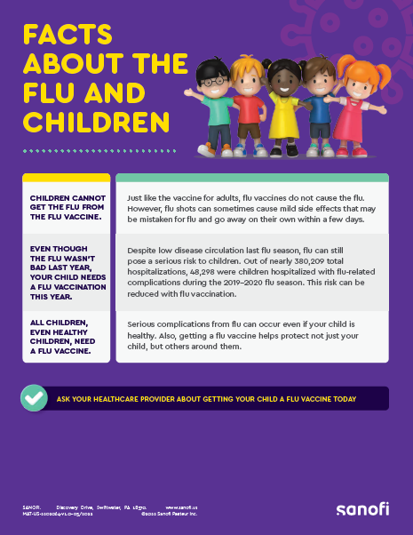

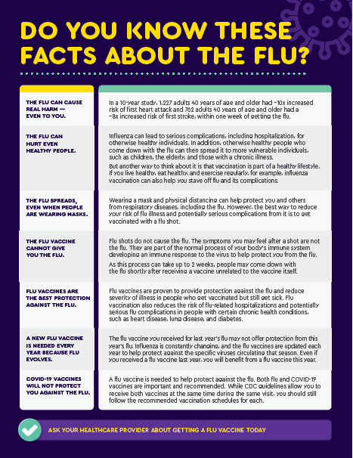
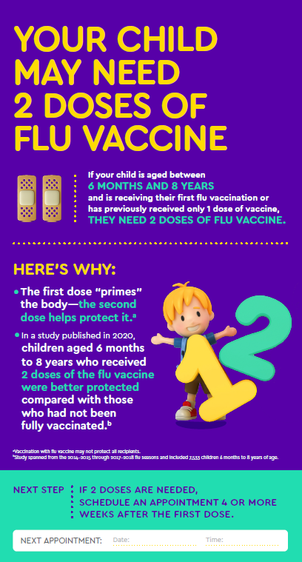

Patient Education Materials to Help Increase Flu Vaccination Coverage
Resources for your patients to learn more about the burden of flu and the importance of flu vaccination
Flu Shot Importance
Dispelling Flu Myths
Pediatric Tear Pad
Clingz (Spanish & English)

Slide 16
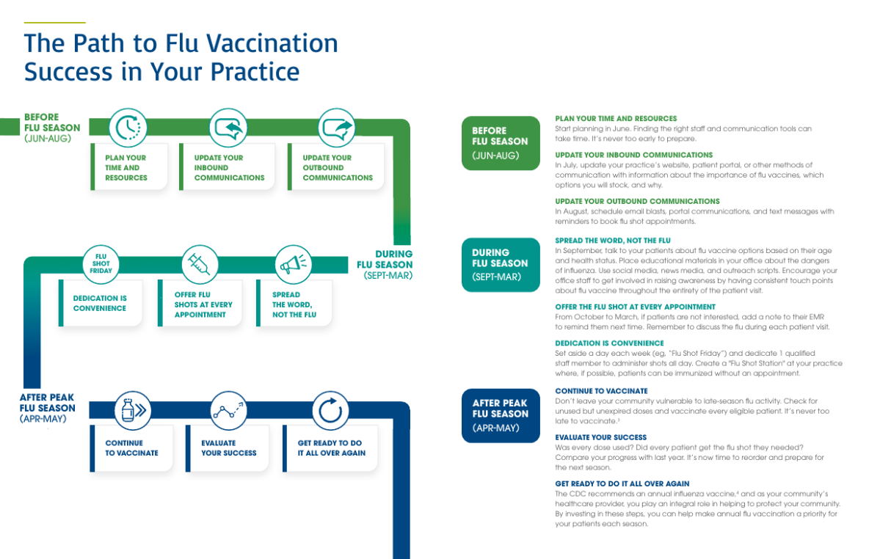
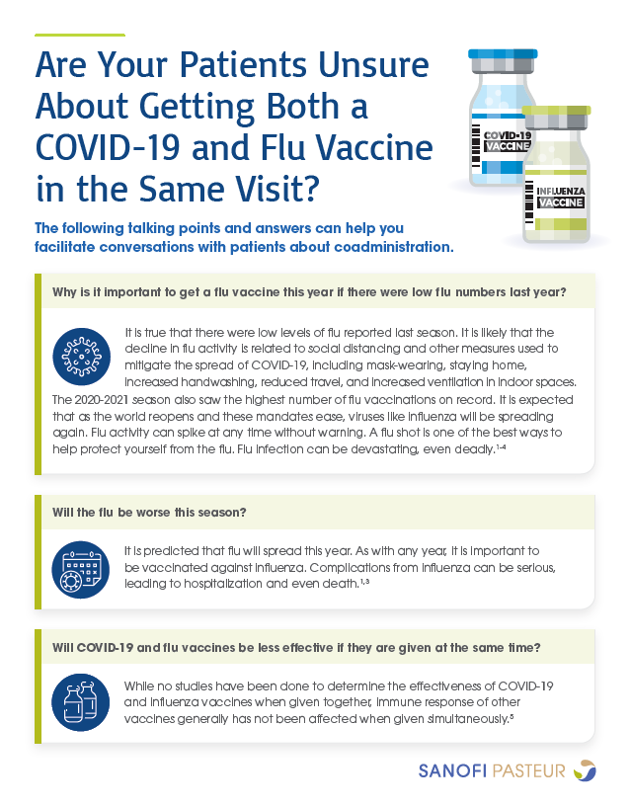
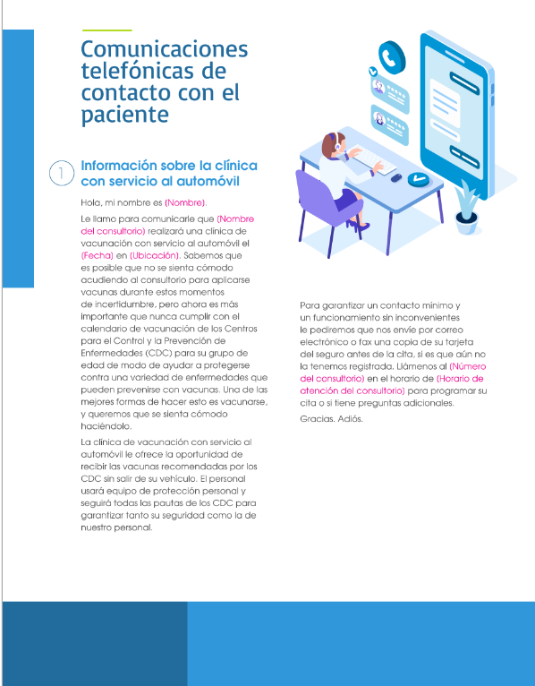
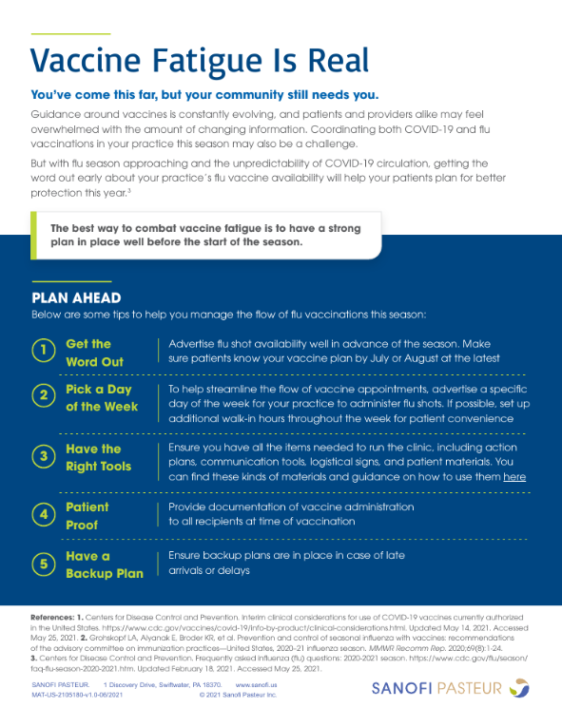
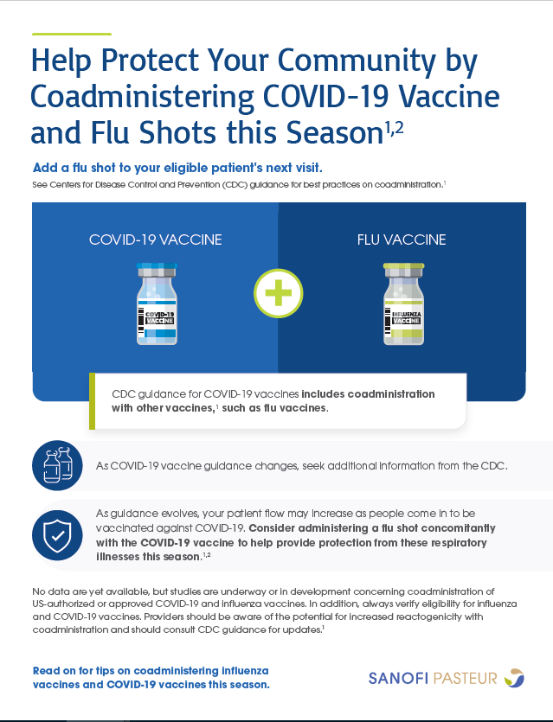
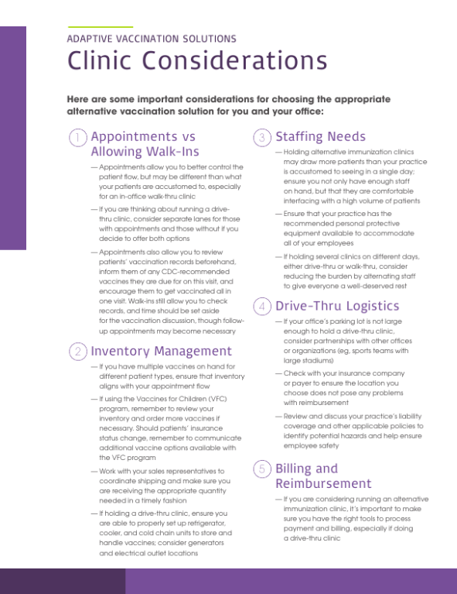
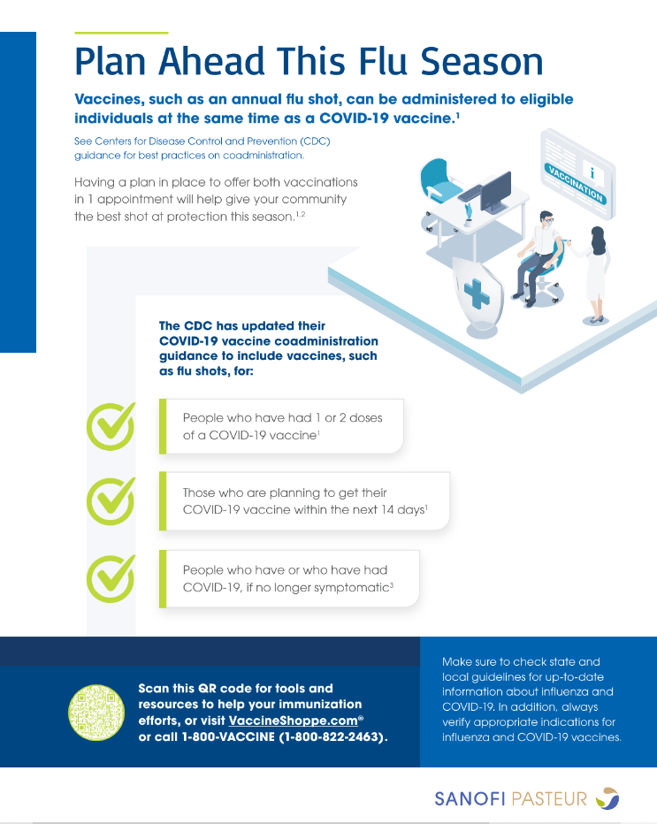
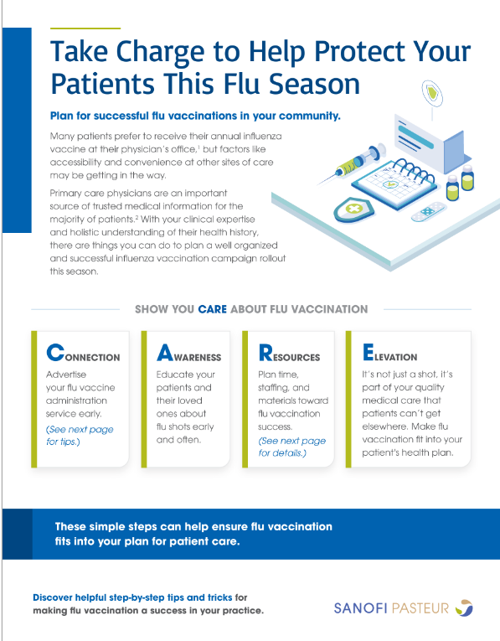
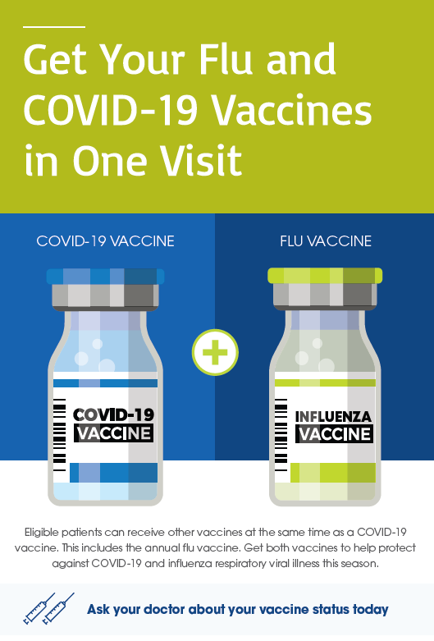
Adaptive Vaccination Solutions Overview and Clinic Signage
Comprehensive clinic kit to help protect patients against flu with alternative immunization approaches
Clinic Guidance
Planning & Coadministration Resources

Slide 17

WellConnect Available to Support Patient Reminder Recall
Reach all your patients with just one call or text
WellConnect allows you to reach out to your patients efficiently. With one call or text, you can send important health and vaccine information to thousands of patients at once.
An easy-to-use tool that can support providers in educating patients about the importance of flu immunizations through unbranded messages.
Providers have the option to send templated and unbranded messages at no cost to them* or pay for customized messages to send to their patients (through Text-Em-All directly).
    Help increase patient visits and immunizations
    Assist your office with improving overall patient health
    Save time and make your office more efficient
    Be more cost-effective and grow your practice
* Subject to program cap established by Sanofi

Slide 18
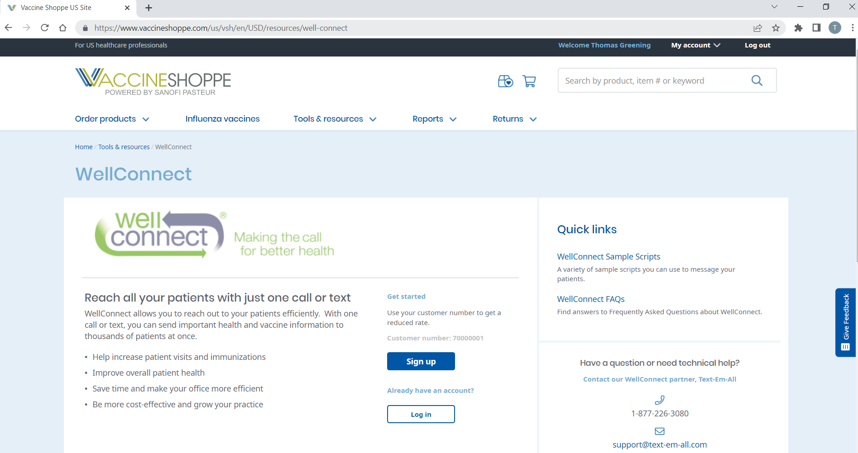
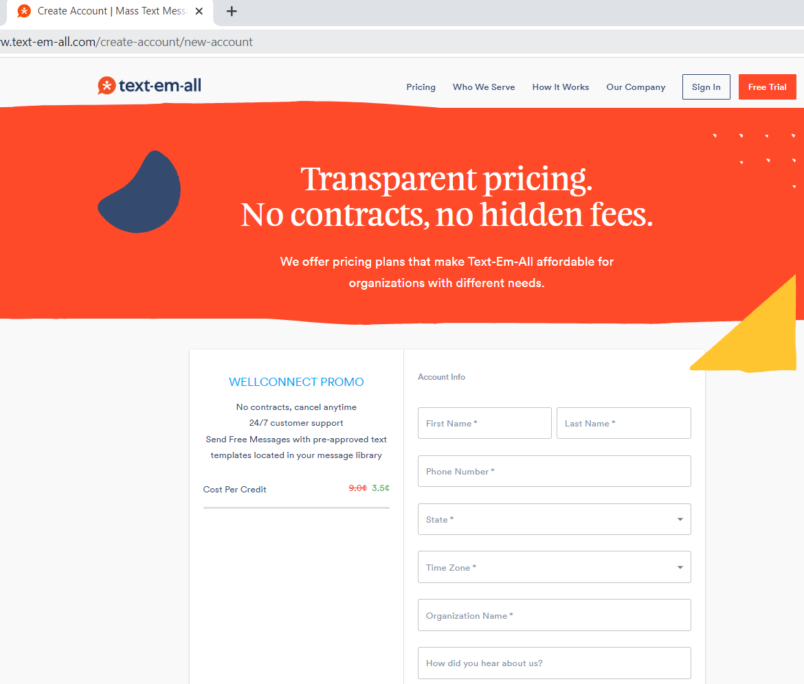
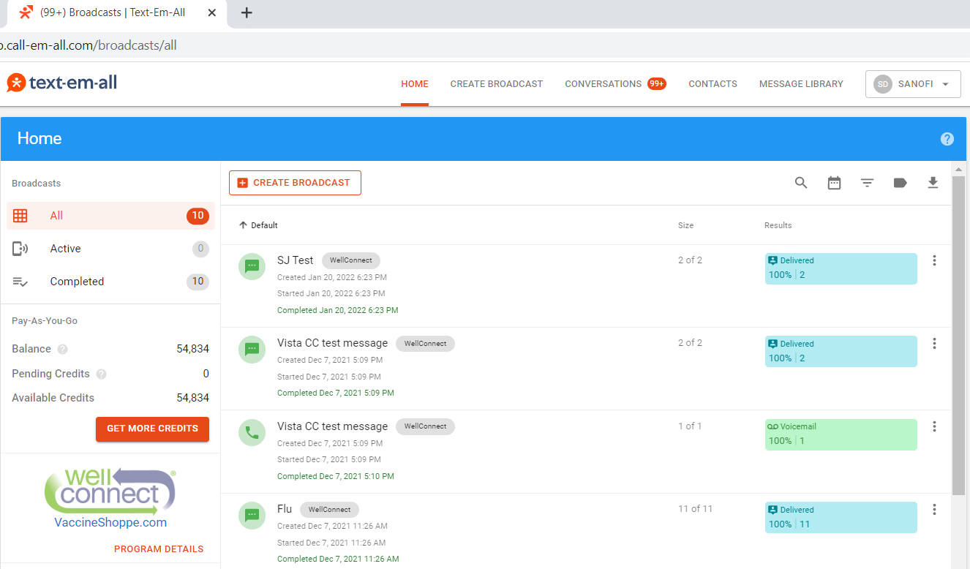
Easily Navigate the Process for WellConnect
Reach all your patients with just one call or text
1
Customers with a VaccineShoppe account can sign up for WellConnect via VaccineShoppe.com
Customers are redirected to vendor site to create a WellConnect account
Customers use vendor site to manage and deploy messages directly to their patients
Example of
Pre-Written Scripts:
Hello! This is {{CompanyName}}. Our records indicate that you received a COVID-19 vaccination earlier this year. It’s critical that our patients understand that like COVID-19, influenza poses significant risk to the elderly and those with underlying conditions. Influenza vaccination can help reduce the risk of influenza infection. Please call {{UserPhone}} to schedule your flu shot now.
Hello! This is {{CompanyName}}. The most important thing you can do this flu season to help protect you and your family against influenza is to receive your annual influenza vaccination. Please call {{UserPhone}} to schedule your flu shot now.
2
3

Slide 19
Thank you

